Slide 1


ADHI COLLEGE OF ENGINEERING AND TECHNOLOGY
Department of Electronics and Communication Engineering
DATE:26-02-2025

Slide 2
WEARABLE SMART GLASSES FOR OBJECT RECOGNITION AND BLIND NAVIGATION
Name of the supervisor
Mr. DINESH BABU K
Batch Members
1. DHINESH S (410121106016)
2. PREETHI S (410121106057)
3. DIVYA M (410121106023)
4. SANTHOSH E (410121106065)
2

Slide 3
ABSTRACT
Designed a cost-effective, wearable object detection system utilizing the ESP32-CAM, a Wi-Fi-enabled camera development board to assist blind and visually impaired individuals, the system employs computer vision and machine learning algorithms to detect objects and provide real-time auditory feedback. The ESP32-CAM's compact design and low power consumption make it ideal for integration into smart glasses, enhancing mobility and independence for the visually impaired. Key features include object recognition, obstacle detection, and voice feedback. The system's performance is evaluated through experiments, demonstrating its effectiveness in assisting blind individuals in navigating their surroundings.

Slide 4
LITREATURE SURVEY
SI: NO | AUTHOR NAME | TITLE | YEAR | DESCRIPTIONS
01 | I. Jeong, J. Lee, D. Lee, M. A. Nuralievich, J. Kim, and J. Cho | A functional design for smart glasses for low vision people that provides visual assistance based on various image processing technologies | 2022 | This study focuses on smart glasses for individuals with low vision, integrating various image processing technologies to provide visual assistance.
02 | S. Das, S. Saxena, and N. K. Rout | Low-cost smart-glass using ESP-32 | 2021 | The paper presents a low-cost smart glass system based on ESP-32 for real-time object detection and assistance for visually impaired individuals.
03 | A. A. Hafeez, S. U. Rao, S. Ranganath, T. S. Ashwin, and G. R. M. Reddywas | A Google Glass-based real-time scene analysis for the visually impaired | 2021 | This study explores real-time scene analysis using Google Glass, enhancing navigation and situational awareness for the visually impaired.

Slide 5
04 | O. B. Al-Barrm and J. Vinouth | 3D ultrasonic stick for blind | 2020 | A smart walking stick equipped with 3D ultrasonic sensors is proposed to help blind individuals detect obstacles and navigate safely.
05 | A. Raj, M. Kannaujiya, I. Bhardwaj, A. Bharti, and R. Prasad | Model for object detection using computer vision and machine learning for decision making | 2019 | The paper presents a model leveraging computer vision and machine learning for object detection to support decision-making.
06 | A. Suresh, C. Arora, D. Laha, D. Gaba, and S. Bhambri | Intelligent smart glass for visually impaired using deep learning, machine vision techniques, and ROS | 2019 | This work integrates deep learning and the Robot Operating System (ROS) to develop intelligent smart glasses for the visually impaired.

Slide 6
07 | D. J. Robinson, L. H. G. Ray, J. B. Kelly | Assistive Technologies for the Visually Impaired: A Review on Object Detection and Navigation | 2019 | It includes a section dedicated to wearable systems using Wi-Fi-enabled cameras like ESP32-CAM and highlights how these can be used in real-time systems to guide visually impaired users with minimal computational resources.
08 | P. Selvirajendran | Virtual bulletin board using man-machine interface (MMI) for authorized users | 2019 | The study discusses an MMI-based virtual bulletin board, focusing on user accessibility and authentication
09 | S. Tosun and E. Karaarslan | Real-Time Object Detection Application for Visually Impaired People: Third Eye | 2018 | This study introduces a real-time object detection application designed for visually impaired individuals using deep learning techniques.

Slide 7
EXISTING SYSTEM
The existing ESP32-based smart glasses system for object detection utilizes a camera module to capture images of the surroundings, which are then processed by the ESP32 microcontroller using computer vision algorithms.
The system employs object detection models, such as YOLO or SSD, to identify objects.
The smart glasses also incorporate sensors, such as ultrasonic or infrared sensors, to detect obstacles and provide proximity alerts.
The proximity alert feature of the ESP32-based smart glasses for object detection warns the user of the presence of nearby objects, providing a simple alert without measuring or indicating the distance of the objects.

Slide 8
DRAWBACKS
Lack of Distance Measurement
False Positives
No Audio Description
Limited Object Recognition

Slide 9
PROPOSED SYSTEM
The system utilizes a high-resolution camera to detect objects and measure distances, providing users with a 3D audio feedback of their surroundings.
The system also incorporates machine learning algorithms to recognize and classify objects, and provides users with audio descriptions of the objects, enhancing their understanding of their environment.
The proposed system aims to address the limitations of existing systems by providing accurate distance measurement, object recognition, and audio descriptions, ultimately enhancing the mobility and independence of blind individuals.

Slide 10
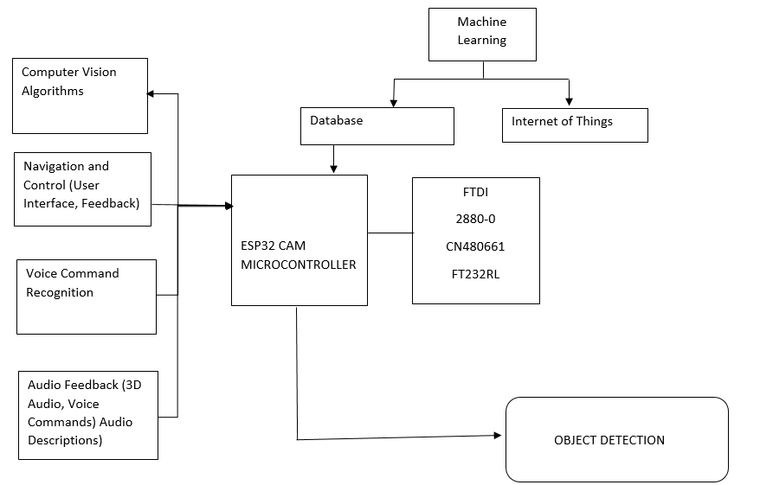
PROPOSED ARCHITECTURE

Slide 11
WORKING PRINCIPLE
STEP 1:IMAGE CAPTURE
ESP-32 CAM captures images of the surroundings then images are processed and transmitted to the computer vision algorithm
STEP2:OBJECT DETECTION
Computer vision algorithm detects objects in the image then the Algorithm identifies obstacles, people and other objects
STEP3:OBJECT RECOGNIZATION
ML Algorithm classifies detected objects. Algorithm recognizes specific objects such as human, chairs, doors
STEP4:DISTANCE MEASUREMENT
System generates the distance between the object and the wearer and instructs them

Slide 12
STEP 5:REAL-TIME AUDITORY FEEDBACK
Speaker provides real-time auditory feedback to the user. Feedback includes information about detected objects, obstacles and navigation instructions
STEP 6:SYSTEM EVALUATION
System performance is evaluated through experiments. Experiments assess the system’s accuracy, reliability and effectiveness in assisting blind individuals

Slide 13
ADVANTAGES
Enhanced Efficiency.
Cost Reduction.
Improved Safety.
Real-time Monitoring and Control.

Slide 14
APPLICATIONS
Home automation
Industrial automation
Smart agriculture
Robotics
Drones
Smart Grid Management
Prototyping and Development

Slide 15
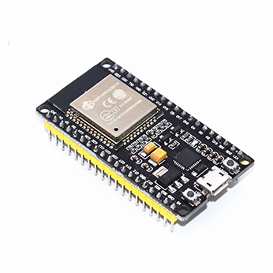
HARDWARE SPECIFICATION ESP32 MICROCONTROLLER

Slide 16
ESP32 MICROCONTROLLERS
The ESP32 is a series of microcontrollers, tiny computers that can be used in a variety of electronic devices. The ESP32 isn't just another microcontroller; it's a powerhouse for embedded systems and IoT.
It boasts a dual-core processor for efficient multitasking, built-in Wi-Fi and Bluetooth for seamless connectivity, and a variety of communication interfaces (UART, SPI, I2C, GPIO) to connect to sensors, actuators, and other devices.

Slide 17
APPLICATIONS
Home automation
Industrial automation
Smart agriculture
Robotics
Drones
Smart Grid Management
Prototyping and Development

Slide 18
SOFTWARE SPECIFICATION
MACHINE LEARNING
Machine learning is a subset of artificial intelligence (AI) that involves training algorithms to learn from data and make predictions or decisions without being explicitly programmed. The machine learning process typically involves data collection, preprocessing, model selection, training, evaluation, and deployment. Various algorithms, such as linear regression, decision trees, random forests, support vector machines, and neural networks, are used in machine learning

Slide 19
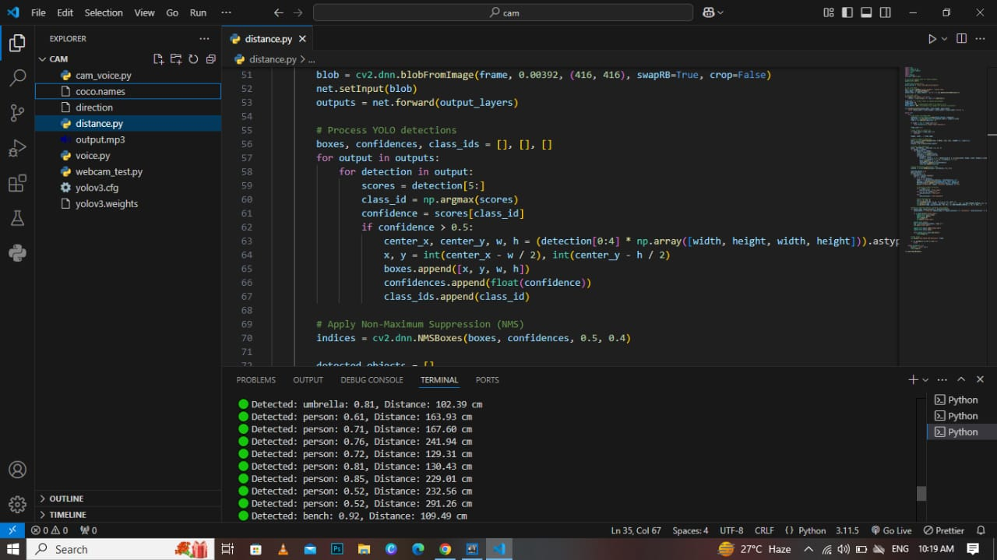
OPEN CV WITH YOLO OBJECT DETECTION

Slide 20
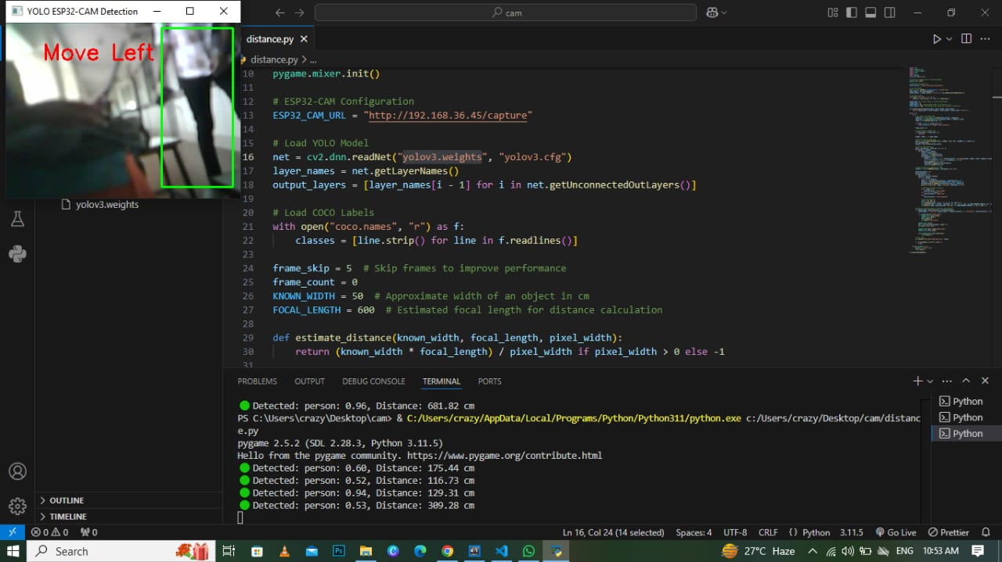
OBJECT DETECTION AND GUIDING TO MOVE

Slide 21
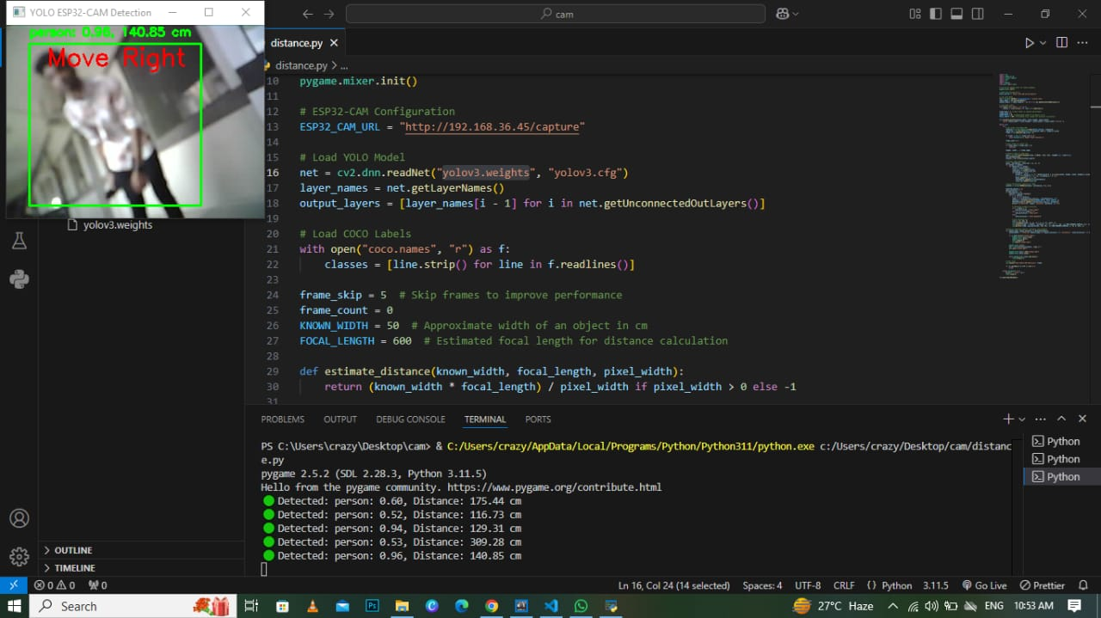
DETECTING OBJECT WITH METRES

Slide 22
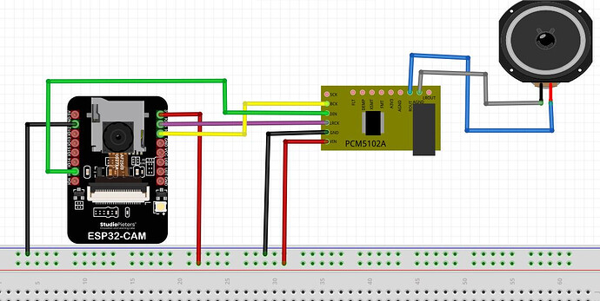
MONITORING KIT
CIRCIUT DIAGRAM

Slide 23
CONCLUSION
The ESP32-based smart glasses for object detection have the potential to revolutionize the lives of blind individuals by providing them with a wearable, affordable, and user-friendly solution for navigating their surroundings. By leveraging machine learning algorithms, computer vision, and sensor fusion, these smart glasses can accurately detect and identify objects, obstacles, and people, and provide real-time audio feedback to the user. With its compact design, low power consumption, and Wi-Fi connectivity, this device can be easily integrated into daily life, enabling blind individuals to move around with greater confidence, independence, and safety. Overall, the ESP32-based smart glasses for object detection offer a promising solution for promoting inclusivity, accessibility, and empowerment for the visually impaired community.

Slide 24
REFERENCES
A. Raj, M. Kannaujiya, I. Bhardwaj, A. Bharti, and R. Prasad, “Model for object detection using computer vision and machine learning for decision making,” International Journal of Computer Applications, vol. 181, no. 43, Mar. 2019, doi: 10.5120/ijca2019918516.
S. Tosun and E. Karaarslan , “Real-Time Object Detection Application for Visually Impaired People: Third Eye,” 2018 International Conference on Artificial Intelligence and Data Processing (IDAP), Malatya, Turkey, 2018, pp. 1-6, doi: 10.1109/IDAP.2018.8620773.
P. Selvirajendran , “Virtual bullet in board using man-machine interface (MMI) for authorized users,” Indian Journal of Science and Technology, vol. 12, no. 34, Sep. 2019, doi: 10.17485/ijst/2019/v12i34/112683.

Slide 25
REFERENCES
4.P. S. Rajendran, “AREDAI: augmented reality based educational artificial intelligence system,” International Journal of Recent Technology and Engineering, vol. 8, no. 1, May 2019.
5.A. Suresh, C. Arora, D. Laha, D. Gaba, and S. Bhambri, “Intelligent smart glass for visually impaired using deep learning machine vision techniques and robot operating system (ROS),” Advances in Intelligent Systems and Computing, vol. 751, 2019, doi: 10.1007/978-3-319-78452-6_10.
6. C. Häne et al., “3D visual perception for self-driving cars using a multi-camera system: calibration, mapping, localization, and obstacle detection,” Image and Vision Computing, vol. 68, pp. 14-27, 2017,doi: 10.1016/j.imavis.2017.07.003.
7. B. Al-Barrm and J. Vinouth, “3D ultrasonic stick for blind,” International Journal of Latest Trends in Engineering and Technology (IJLTET), vol. 6, no. 2, 2020.

Slide 26
8. P. Gharani and H. A. Karimi, “Context-aware obstacle detection for navigation by visually impaired,” Image and Vision Computing,
vol. 64, pp. 103-115, 2017, doi: 10.1016/j.imavis.2017.06.002.
9.H. D. Escobar‐Alvarez et al., “R‐ADVANCE: rapid adaptive prediction for vision‐based autonomous navigation, control, and
evasion,” Journal of Field Robotics, vol. 35, no. 1, pp. 91-100, 2018, doi: 10.1002/rob.21744.
10.I. Jeong, J. Lee, D. Lee, M. A. Nuralievich, J. Kim, and J. Cho “A functional design for smart glasses for low vision people that provides visual assistance based on various image processing technologies,” International Conferenceon Electronics Information, and Communication, pp. 1-3, 2022, doi: 10.1109/ICEIC54506.2022.9748188.

Slide 27
ANY QURIES?

Slide 28
THANK YOU

